Slide 1

Hospitality

Slide 2
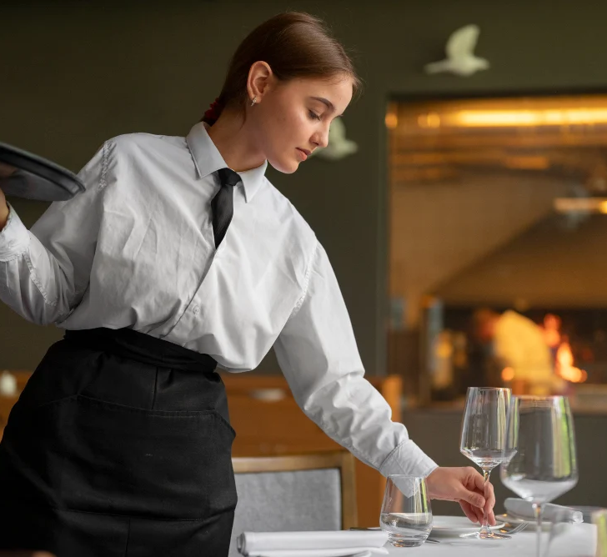
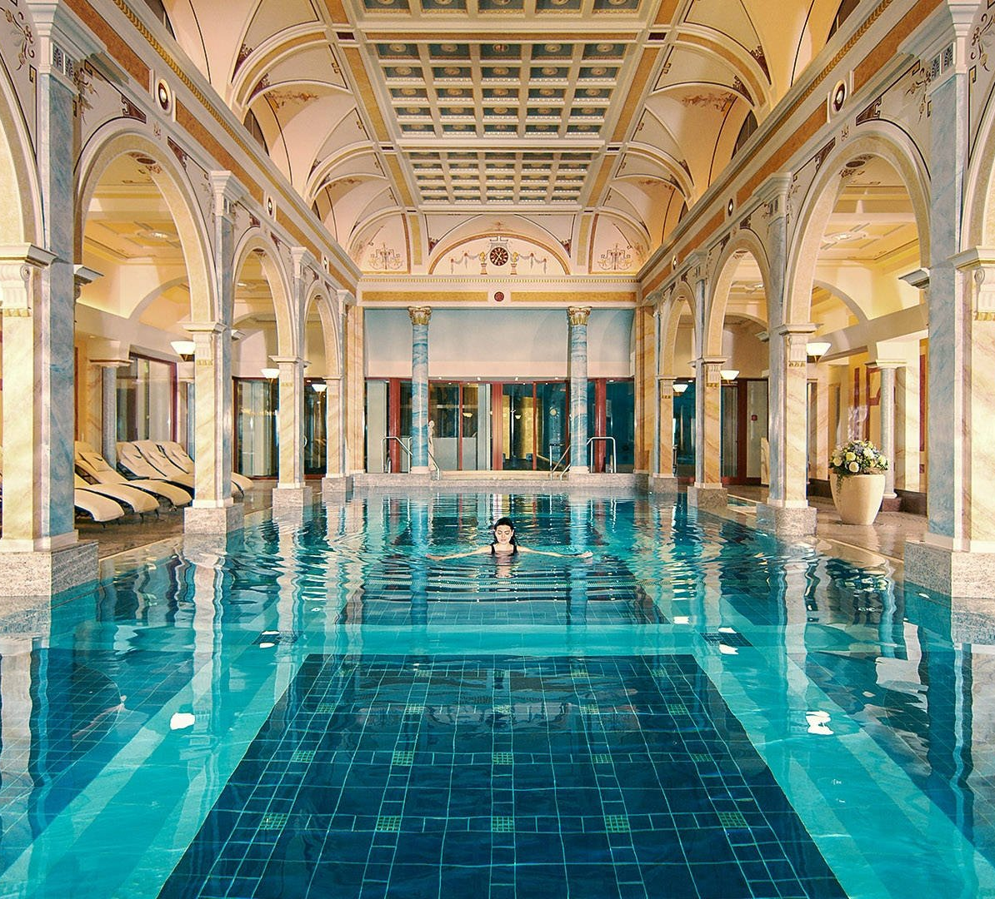
When you and I think of hospitality...in our Western Culture we think about entertaining,. So, what does the bible say about hospitality?

Slide 3
Heb 13:1-14
Keep on loving one another as brothers and sisters. ² Do not forget to show hospitality to strangers, for by so doing some people have shown hospitality to angels without knowing it. ³ Continue to remember those in prison as if you were together with them in prison, and those who are mistreated as if you yourselves were suffering.
⁴ Marriage should be honoured by all, and the marriage bed kept pure, for God will judge the adulterer and all the sexually immoral. ⁵ Keep your lives free from the love of money and be content with what you have, because God has said,
“Never will I leave you;
never will I forsake you.”
⁶ So we say with confidence,
“The Lord is my helper; I will not be afraid.
What can mere mortals do to me?”

Slide 4
OT Hospitality Code
Invitation- you waited for an invitation at a gate of the town or a well- there are many repeated examples of this in scripture.
Screening- to make sure they were strangers and not enemies interview the strangers- letters of recommendation.
Provision-host would wash their feet and provide good food and rest.
Departure- with thanks- and you would never stay more than 2 nights.

Slide 5
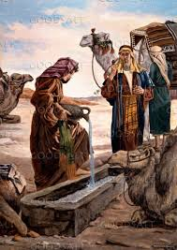
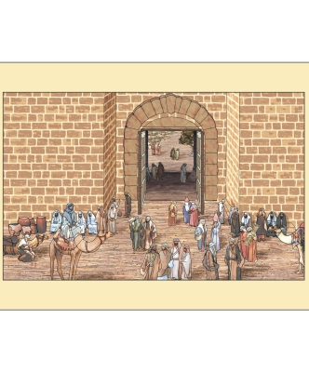
Waiting at the well or the gates of the city

Slide 6
Deuteronomy 10:17-19
For the Lord your God is God of gods and Lord of lords, the great God, mighty and awesome, who shows no partiality and accepts no bribes. ¹⁸ He defends the cause of the fatherless and the widow, and loves the foreigner residing among you, giving them food and clothing. ¹⁹ And you are to love those who are foreigners, for you yourselves were foreigners in Egypt.

Slide 7

Greek word for hospitality: Philoxenia
  Philo is proactive love or ‘love in action’
  Xenos – stranger
  The ancient Greek tradition and cultural value of ‘love of strangers’ embodying deep, unconditional hospitality.

Slide 8
Whats the promise of Hospitality?
John Piper calls it strategic hospitality - ‘when we practice hospitality, we become conduits of Gods hospitality rather than becoming self-decaying cul-de-sacs. The joy of receiving Gods hospitality decays and dies if we do not share that with others.

Slide 9
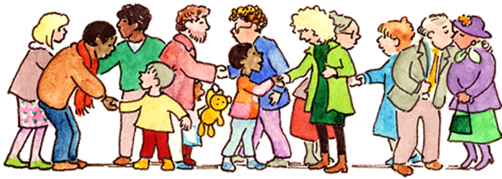
Welcoming the stranger
'Welcoming people into your living space, treating strangers as family, so that God can turn some of them into friends’ Tim Keller
Invite people who are different, don’t always go for the same as you.
The reality is that's it's about relationship not just catering. It really is about loving people. It's a whole other level of being family together.
Welcome the stranger you never know who you may be welcoming!

Slide 10
Practical Points
Welcoming people into your living space
Don't wait for your life to be perfect before you are hospitable. Your house will never be large enough; you will never have enough budget, energy or time.
If you are not feeling part of church, then being hospitable is a great way to feel a part.
Be creative and keep it simple it doesn't have to be complicated. If you wait for everything to be correct it probably won’t happen. So don't wait. Just do it.
It will look different for everyone.
Be intentional.

Slide 11
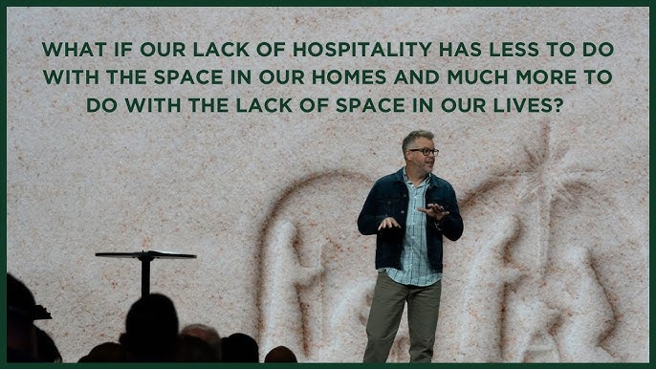

Slide 12

The Banqueting table

